Slide 1

The Application of HBase in New Energy Vehicle Monitoring System
颜禹 Yan Yu
博尼施科技 Burnish Technology Co. Ltd

Slide 2
content
Background
Challenges and Decisions
System architecture
Why HBase
Challenges with HBase
Data backup in HBase
Conclusion
Prospect

Slide 3
Backgroud
100k running vehicles online
Send 2 packages per minute every vehicle
Send 1 package per second when vehicle alarming
Data space
the origin package size is 1KB
parsed package size is about 7KB
one vehicle will produce 20MB data per day
2TB data were generated per day
290 million rows need to write to Database every day
Concurrency
3.3k persistent tps
100k persistent connections
3.3MB origin data needs to parse per second
23.1MB parsed data needs to storage in Database per second

Slide 4
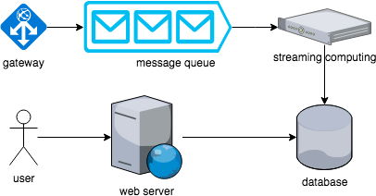

Slide 5
Challenges
Small team
Limited funds, machines
Short deadline
System integration
How to handle the huge amount of vehicle data
Demands are very foggy

Slide 6
Decisions
Language
Message queue
Database
Develop flow
Micro service
Monolithic service
Deploy and maintain
Cloud
Native data center

Slide 7
Language
C/C++
High performance
Hard to integrate
Long development time
Java
High performance
Rich third part packages
Easy to integrate with big data system, i.e. Hadoop, HBase, spark
Python
Sprint development
Rich third part packages
Performance issue with multi thread
Golang
Easy to write multi thread program
There is no Golang developer in our team

Slide 8
Message
Redis
High performance
High memory requirement
Hard to scale
Celery
More fit for distribution task
Easy to develop with python
Redis or rabbitmq as it’s backend
Kafka
Write to disk first to ensure the message security
Support consumer group
Auto balance
Enough performance for our system
Easy to scale
Rabbitmq
Classic message queue
Performance

Slide 9
Database
MySql
Relational database
Fit for storage static information
ORM support
MongoDB
Document based
ORM support
Hard to maintain and scale
Hbase
Column database
High write performance
Easy to handle TB
Easy to scale
OpenTSDB
Time series database
Based on HBase

Slide 10
Monolithic service vs micro service
Monolithic service
Easy to develop when system is not very complicate
Acceleration for development
Build the basic system due to the foggy demands
Micro service
Easy to scale in a complicate system
Rapid iteration
More developers requirement

Slide 11
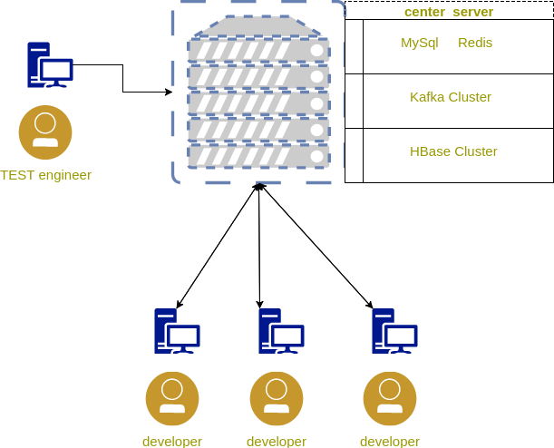
Develop flow
Dependences on central server.
Dependences on central server.
Easy to setup on one server
Single point failure risk
Confliction over multi developers

Slide 12
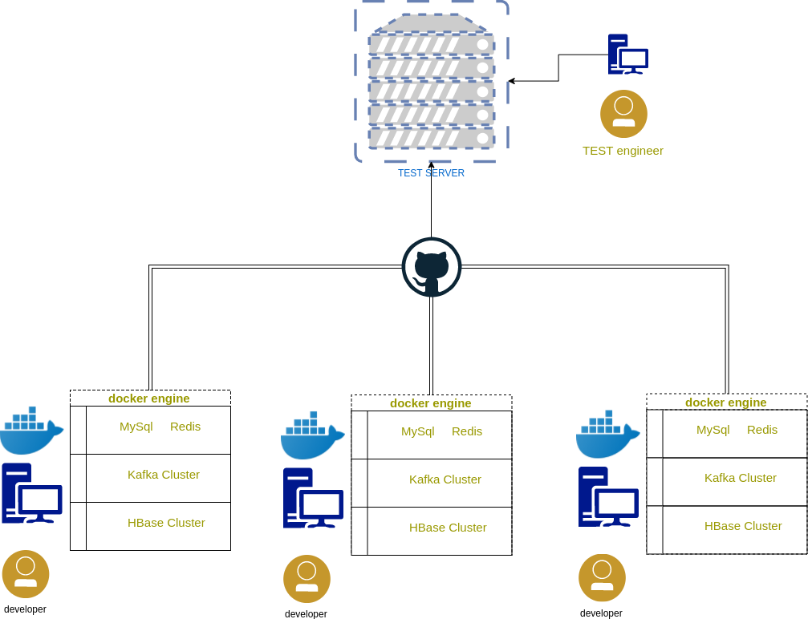
Develop flow
Dependences on individual docker engine.
Easy to setup with docker-compose
No single point risk
High memory develop machine requirement(starting from 32GB)

Slide 13
Deploy and maintain
Cloud
Easy setup
Low cost with small scale
Fast deployment
No employees
Professional maintainer at aliyun
Native data center
Hard setup
Expensive cost with small scale
Professional employee to maintain our data center

Slide 14
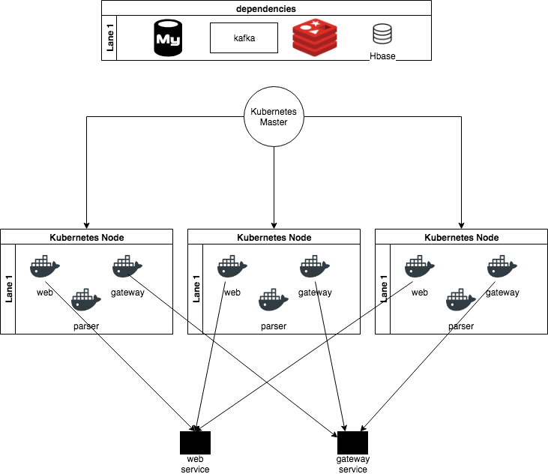
Deploy and maintain
Deploy system with kubernetes
Easy to management
Rapid scale
Compute and storage split separation
Deploy basic component with cloud service
Fast deploy
Careless
Easy to get high available service
No employees

Slide 15
How a small team
hold a high performance system
Individual develop environment with docker and docker-compose.
Deploy system with kubernetes to reduce the operation cost.
Develop with pure python code.
Just build the basic system, another demands delay to second phase development.

Slide 16
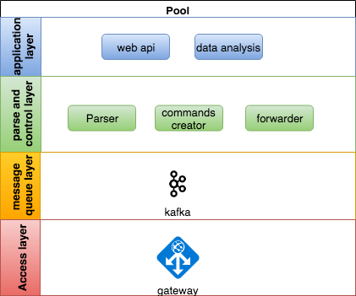
The System Architecture

Slide 17
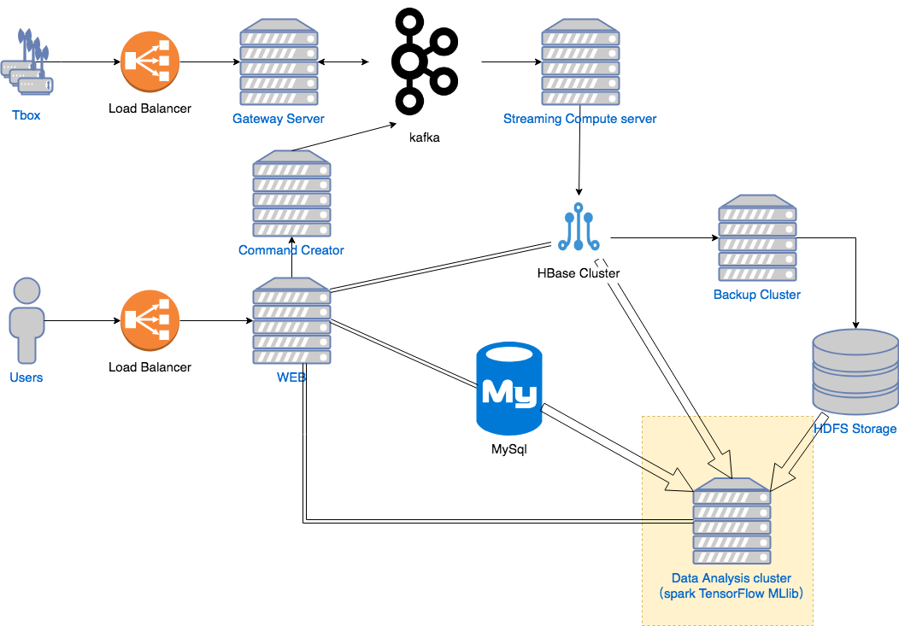
The System Architecture

Slide 18
System maintain
Application scale
Application scale with kubernetes
Basic component with cloud service
CI/CD
CI with jenkins
CD with jenkins and kubernetes
Data Backup
Mysql backup
Hbase backup
Message backup

Slide 19
Why HBase?
High write performance
Quick response for query
Easy to scale
SQL support with phoenix
HBase SAAS provide by Aliyun

Slide 20
Connect to Hbase
cluster with python
Provide native java API
Connect HBase with thrift
Happybase provide pythonic API
SQL support with phoenix

Slide 21
Challenges with HBase
Row key design
Device ID prefix + timestamp
Hash prefix + timestamp
Secondary index
Import phoenix support
Insert index manually
Table design
Short column name
Carefully design the table with demands (i.e. the mileage of every single vehicle)
Complex query is very slow
Create index
Export some results to HDFS or MySql (kylin?)

Slide 22
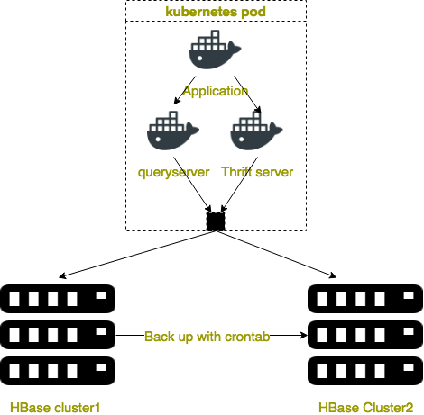
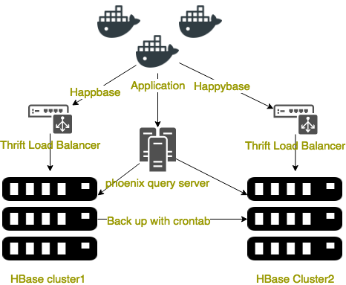
Hbase Cluster

Slide 23
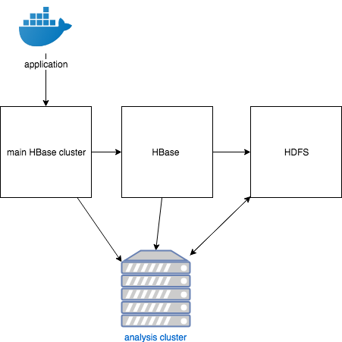
Data Backup Approach
Incremental backup
Compress backup

Slide 24
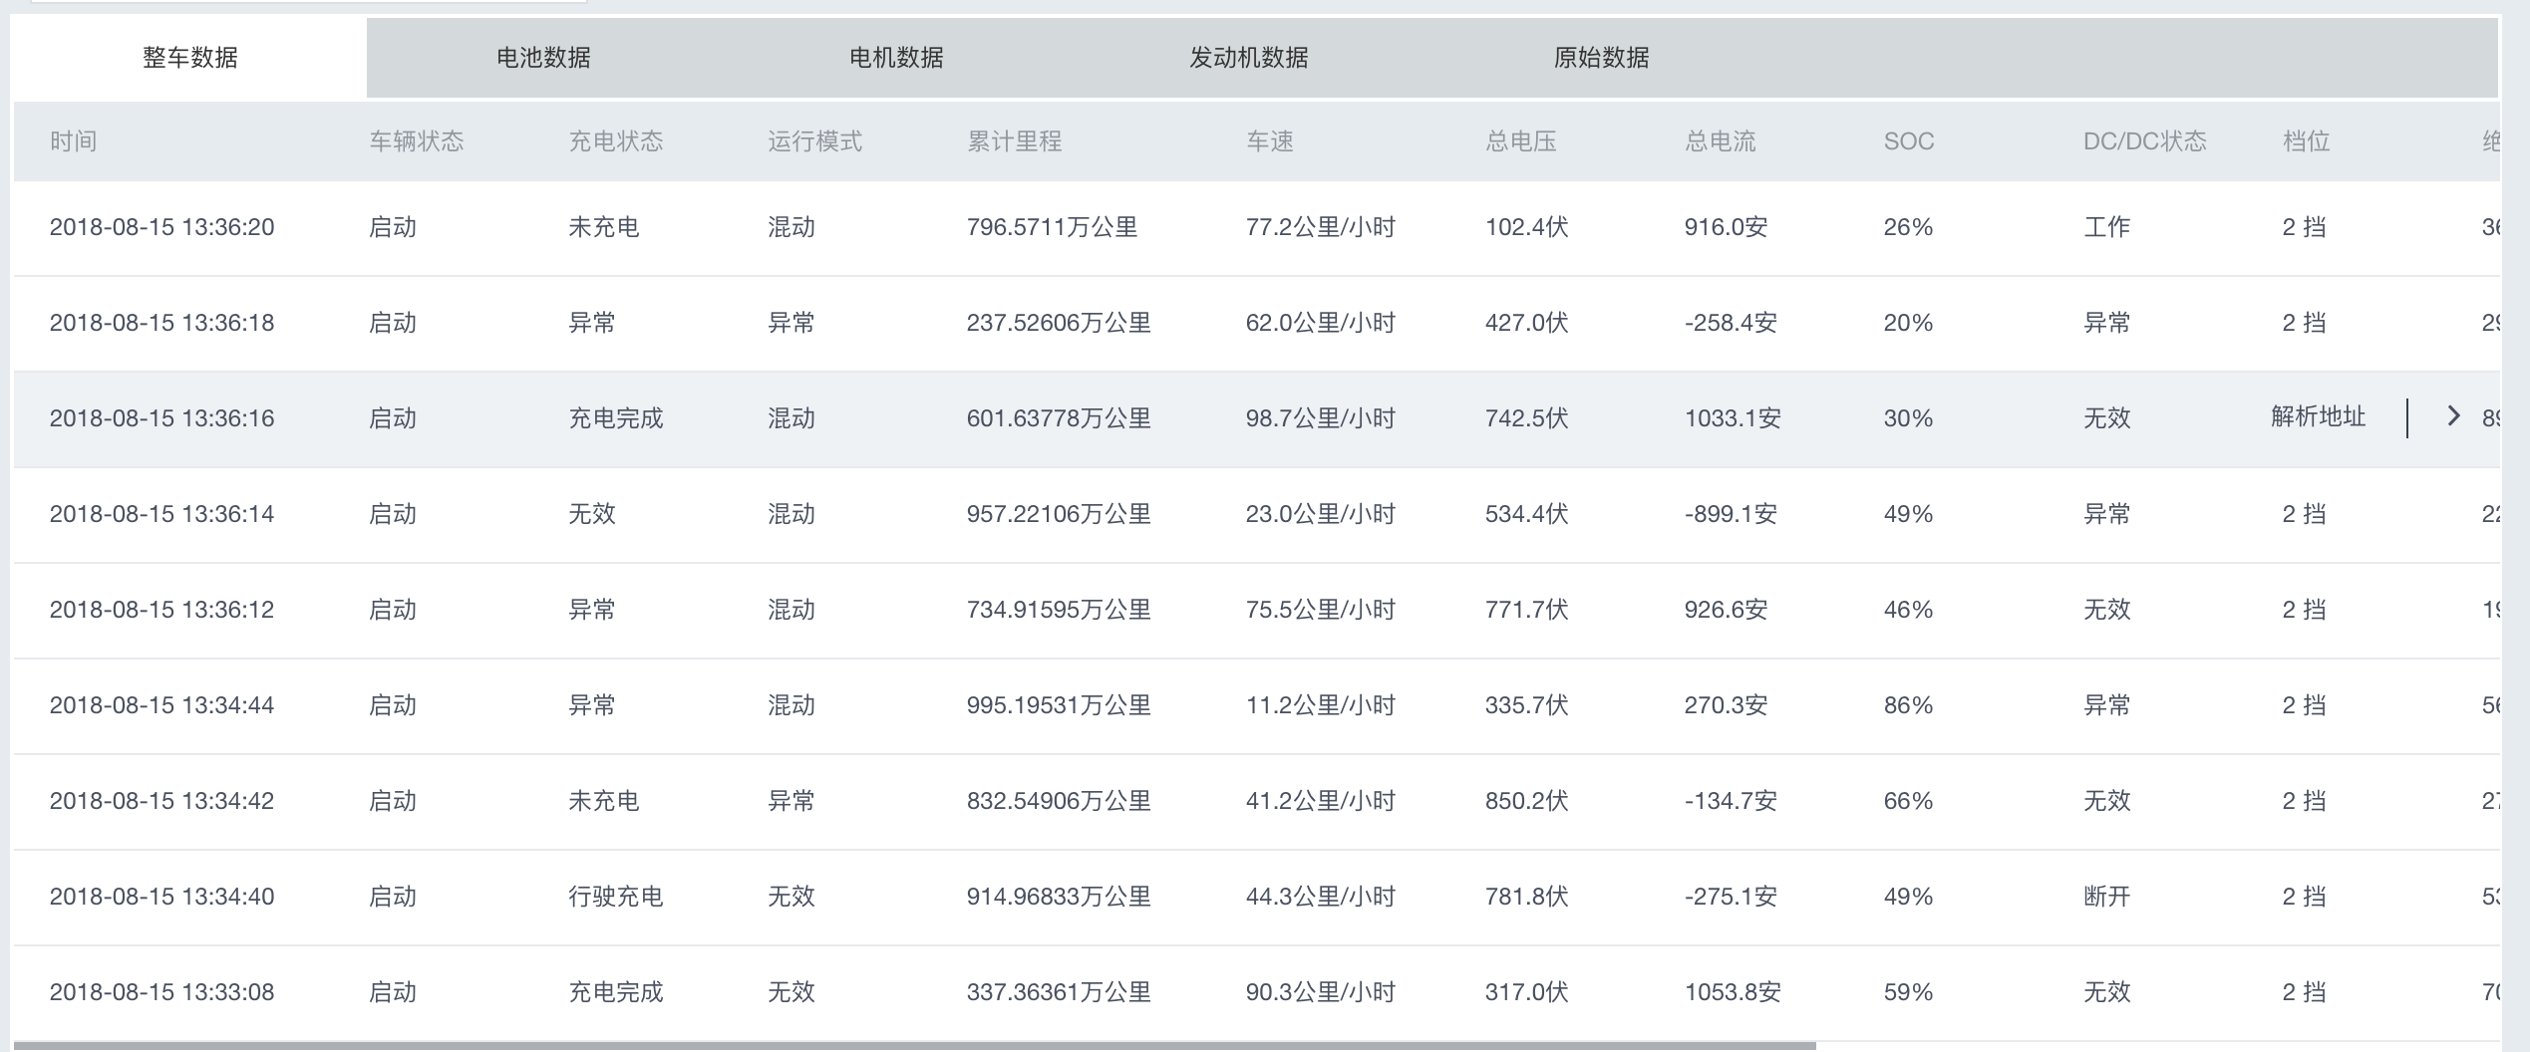
Data sample

Slide 25
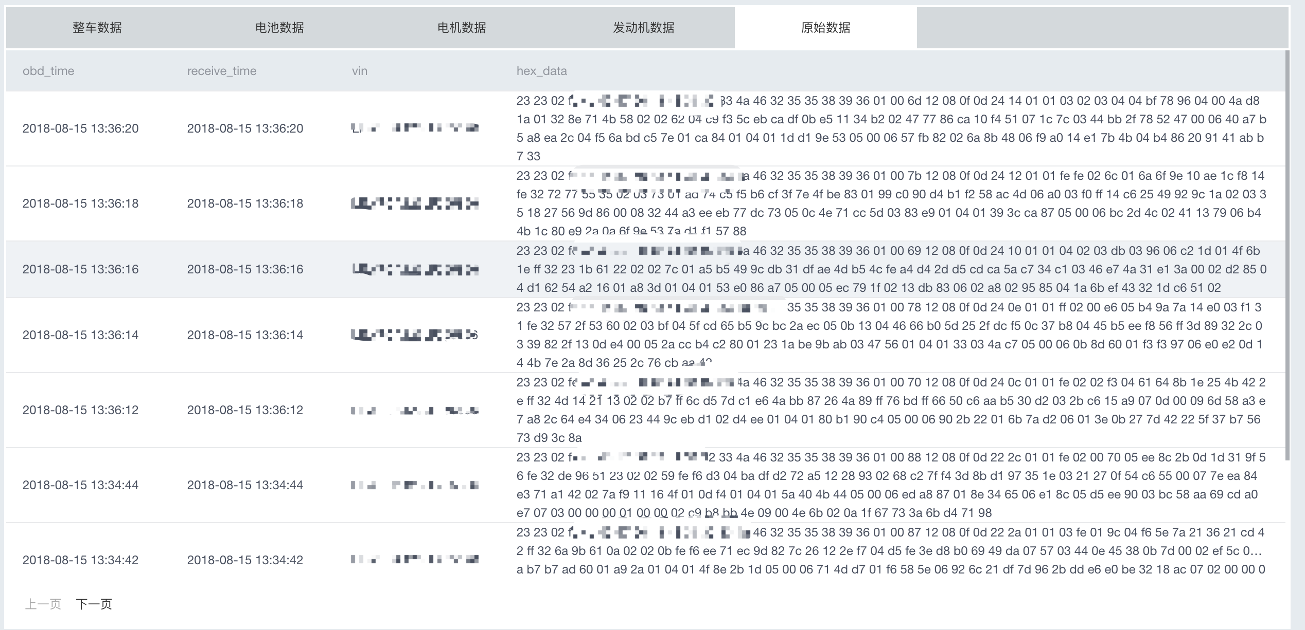
Data Sample

Slide 26
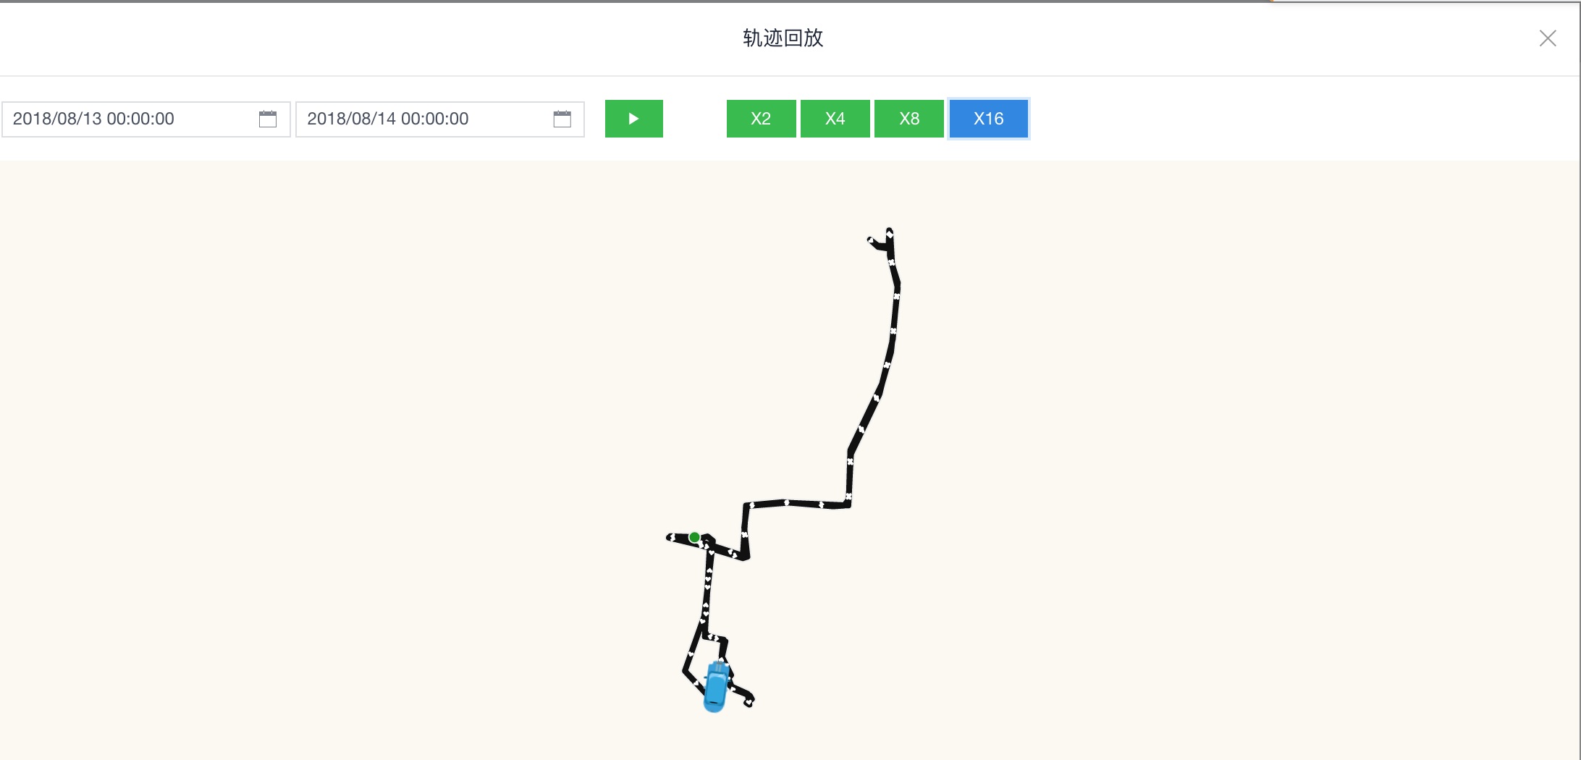
Data Sample

Slide 27
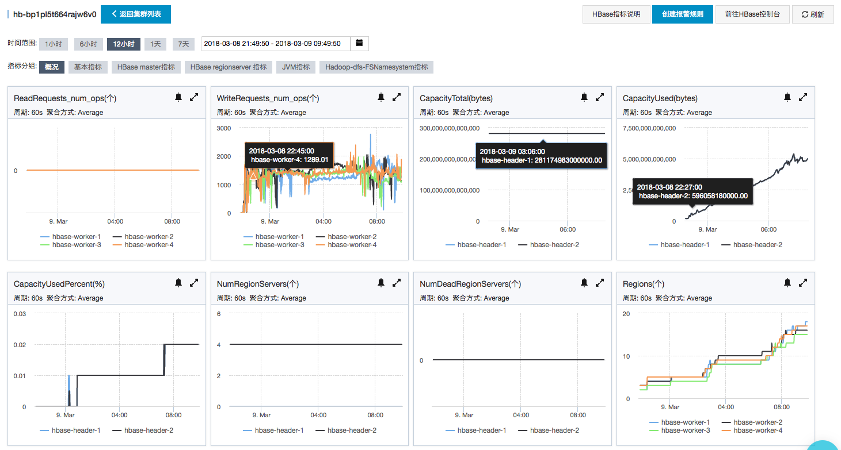

Slide 28
Pain point
Complex query with HBase API still very slow
Phoenix needs create index to accelerate the query speed
Phoenix query still very slow if there is no index in HBase
Complex query needs big size of index in HBase
The queryserver between python and phoenixdb is very weak

Slide 29
Conculsion
Introduced the background of monitoring system
Our decisions of the system
Why we choose HBase as our main database
How we deploy and maintain the system
Introduced the practice of HBase in the system

Slide 30
Prospect
Rewrite high performance component with golang.
Split the monolithic system into micro service when the system becomes complex
Data analysis
Fault diagnosis
Predict the vehicle status
Data compression
Opentsdb
Combine the elasticsearch and Hbase in our application.

Slide 31
Thanks

